Slide 1
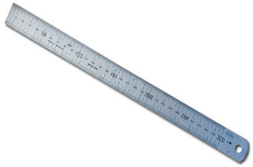

Basic marking cutting hand tools.
1. Ruler
- It is used to measure short distances.
2. Measuring Tape
- It is used to measure shorter or longer distances.

Slide 2
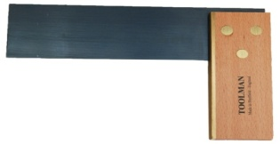
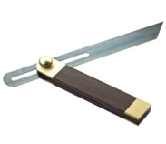
Basic marking cutting and hand tools.
3. Try Square
- It is used for checking square. (internal & external right angles)
4. Bevel
- It is used for making pop marks.

Slide 3
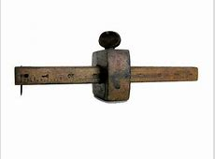
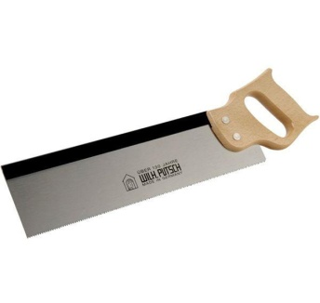
Basic marking cutting hand tools.
5. Marking Gauge
- It is used for drawing lines.
6. Tenon Saw
- It is used for cutting wood.

Slide 4
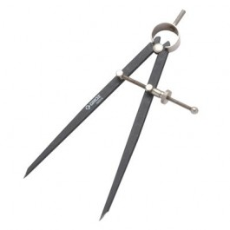

Basic marking cutting hand tools.
7. Divider
- It is used to measure short distances.
8. File
- It is used to measure short or longer distances.

Slide 5
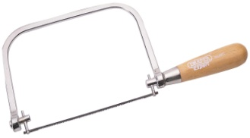

Basic marking cutting hand and power tools.
9. Coping Saw
- It is used for cutting sheet-metals.
10. Chisel
- It is used as a cutting tool.

Slide 6
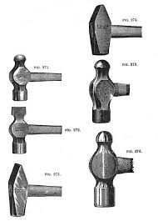
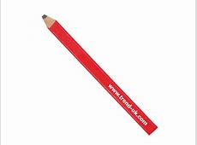
Basic marking cutting and hand tools. (continues)
11. Hammer
- It is used for general hammering in the workshop.
12. Marking Pencil
- It is used for drawing Lines.

Slide 7
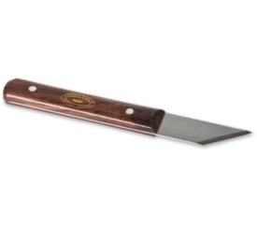
Basic marking cutting and hand tools.
13. Marking Knife
- It is used for drawing lines and cutting in the workshop.
Video:
https://youtube.com/shorts/1_ngAfXi0Wk?si=1juKu0QhlpuinxaK
Feedback: Activity

Slide 8
Kwa Thema Skills School
Subject : Maintenance Marks : 10
Grade : Year 1 Time : 30 mins
Date : / / 2024
Question:1
Name the following marking and cutting hand tools.
1.__________________ 2.______________________
3.___________________ 4. ______________________

Slide 9
5. _________________ 6. ____________________
7. __________________ 8. ___________________
9. __________________ 10. ___________________
(10)

